Slide 1


INFO5100: APPLICATION ENGINEERING DEVELOPMENT
“NeV WELLNESS APPLICATION”
Presented by:
Palanati Neha - 002332745
Vedarani Sawant - 002304068
Vishal Babu - 002304236
Udit Aditya - 002246428

Slide 2



01 - Problem Statement
02 - UML Class Diagram
03 - Proposed Advanced Feature
04 - Stakeholder Roles
05 - Use Cases

Slide 3
01 - Problem Statement
Overview: Address the lack of trust in organic food due to insufficient transparency in the supply chain.
Challenges:
Lack of reliable verification of organic produce authenticity.
Insufficient collaboration between stakeholders (farmers, vendors, regulatory bodies).
Limited consumer access to verified organic food and personalized health services.
Objective: Build a comprehensive platform to provide transparency, build trust, and integrate stakeholders in the organic food ecosystem.

Slide 4
02 - UML Class Diagram
A high-level representation of the system’s architecture:
Classes: Ecosystem, Enterprise, Organization, Role, UserAccount, WorkRequest.
Attributes: Key properties for each class.
Methods: Functions defining the operations for entities.
Relationships: Associations and dependencies between classes.

Slide 5

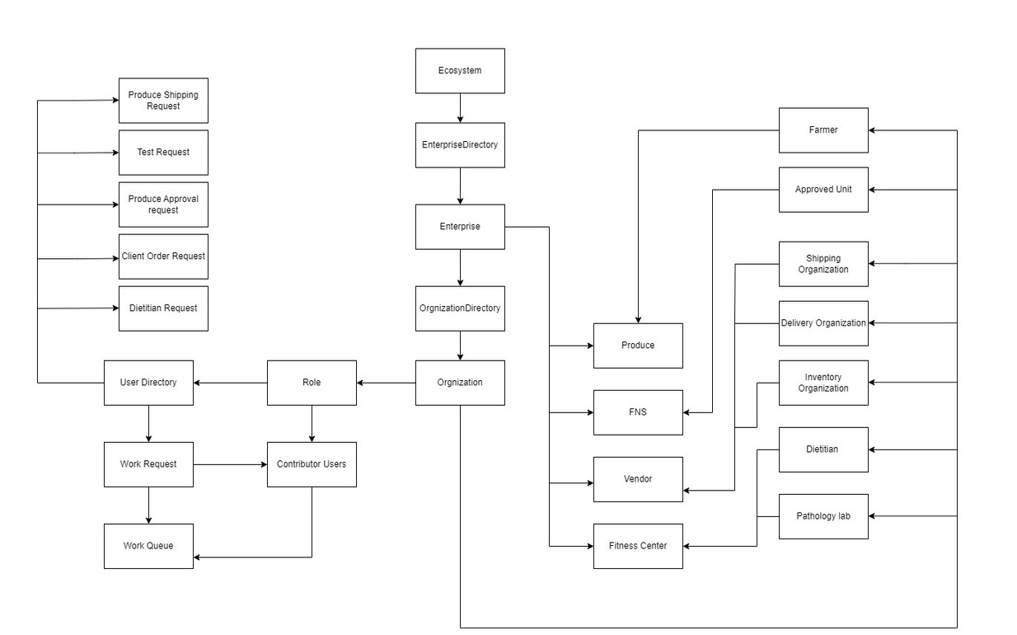


Slide 6

03 - Advanced Feature - Transparent Supply Chain
Objective: Build trust by enabling consumers to verify the authenticity of organic food at every stage.
Core Features:
Integrate with regulatory bodies for certification and compliance tracking.
Transparent workflow for managing requests:
Produce Shipping Requests (Farmer → Vendor).
Produce Approval Requests (Regulatory Body → Vendor).
Dietitian Consultations (Consumer → Dietitian).
Track consumer outcomes via connected fitness centers.

Slide 7
04 - Stakeholder Roles
Farmers:
Cultivate organic produce and ensure compliance with regulatory standards.
Regulatory Bodies:
Certify and approve organic produce.
Vendors:
Manage distribution and coordinate with delivery partners.
Fitness Centers:
Provide personalized health plans and recommend verified organic food.

Slide 8
05 - Use Cases
Consumers:
Access personalized diets based on test results.
Purchase certified organic food.
Farmers and Vendors:
Regularly produce, verify, and ship organic goods.
Fitness Centers:
Connect consumers to dietitians.
Provide health plans and facilitate food purchases.

Slide 9


Thanks

